Slide 1

ZEISS - Open software ecosystem for data-centric model development
Dr. Sebastian Rhode
Software Architect - AI Solutions
Staff Expert
Product Center for Software
19.10.2022

Slide 2



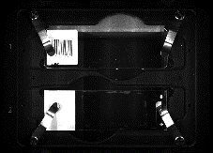
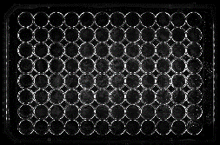

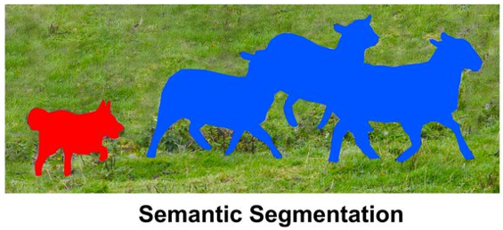
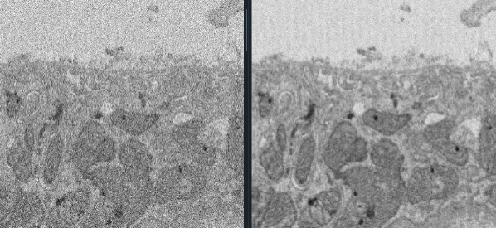
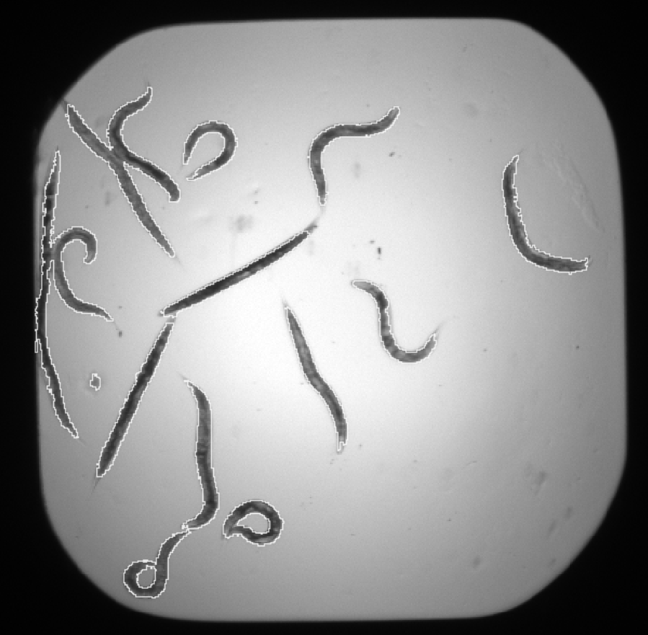
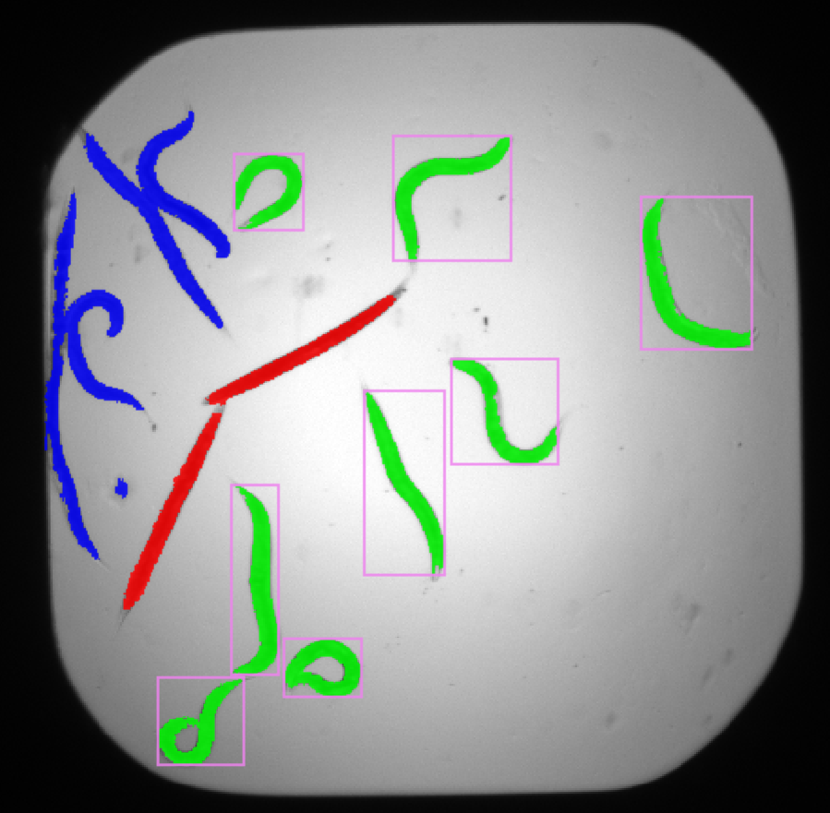

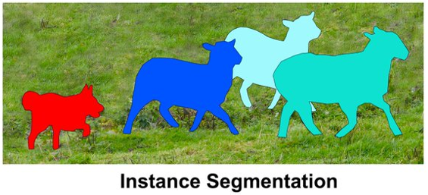

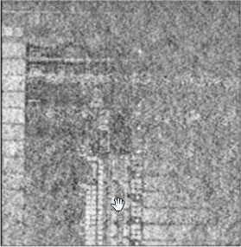
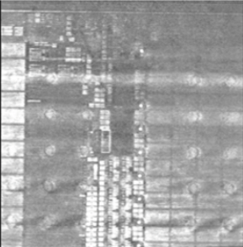
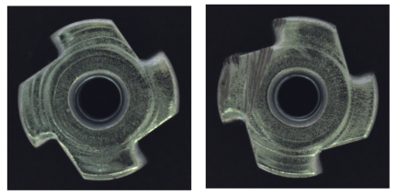

AI solutions @ZEISS microscopy
Image Analysis and Processing
Classification
Segmentation
Processing
Classifying an entire image or individual objects
Refers to classifying at a pixel level
Image corrections
and enhancements
Recognize a Sample Carrier
Denoising & Image2Image
Classify objects in analyzed images
“Good” part vs “Anomaly”
Reconstruction

Slide 3
Mission Statement for AI @ZEISS
Our mission statement for AI @ZEISS Microscopy could be described as:
“Put the scientist back into the driver seat for Deep Learning”
The core message when it comes to Image Analysis & AI solutions is:
“Better data beat better models”

Slide 4
Align Requirements from Academia and Industry with Business Model
Academia wants open and flexible solutions and does not like to be locked in
Industry often wants “Streamlined and Integrated” tools and “one-Button-Solutions” for a specific task
Various of open-source software (OSS) tools that offer specific solutions → What is our business model?
“cloud-computing” is trending, but some users / customers do not want / are not allowed use cloud yet
What tools should a we use? Should we develop our own (build or buy)

Slide 5


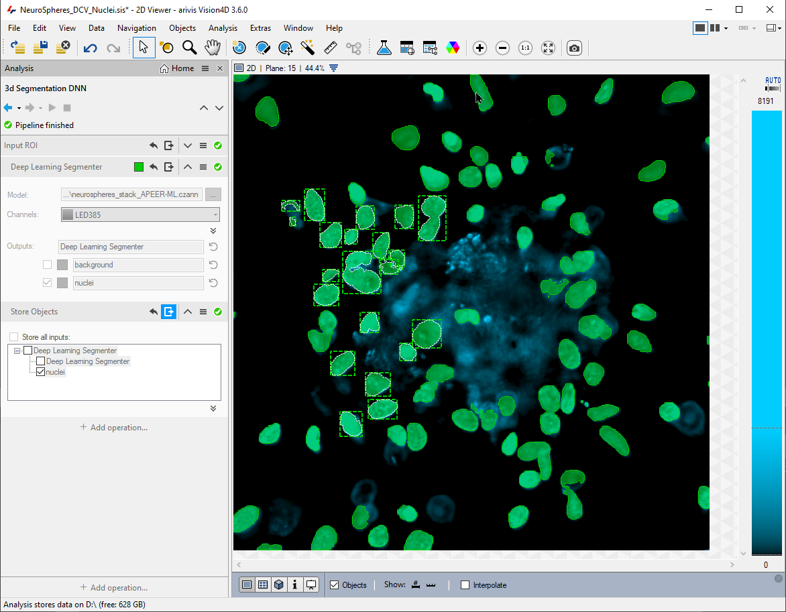
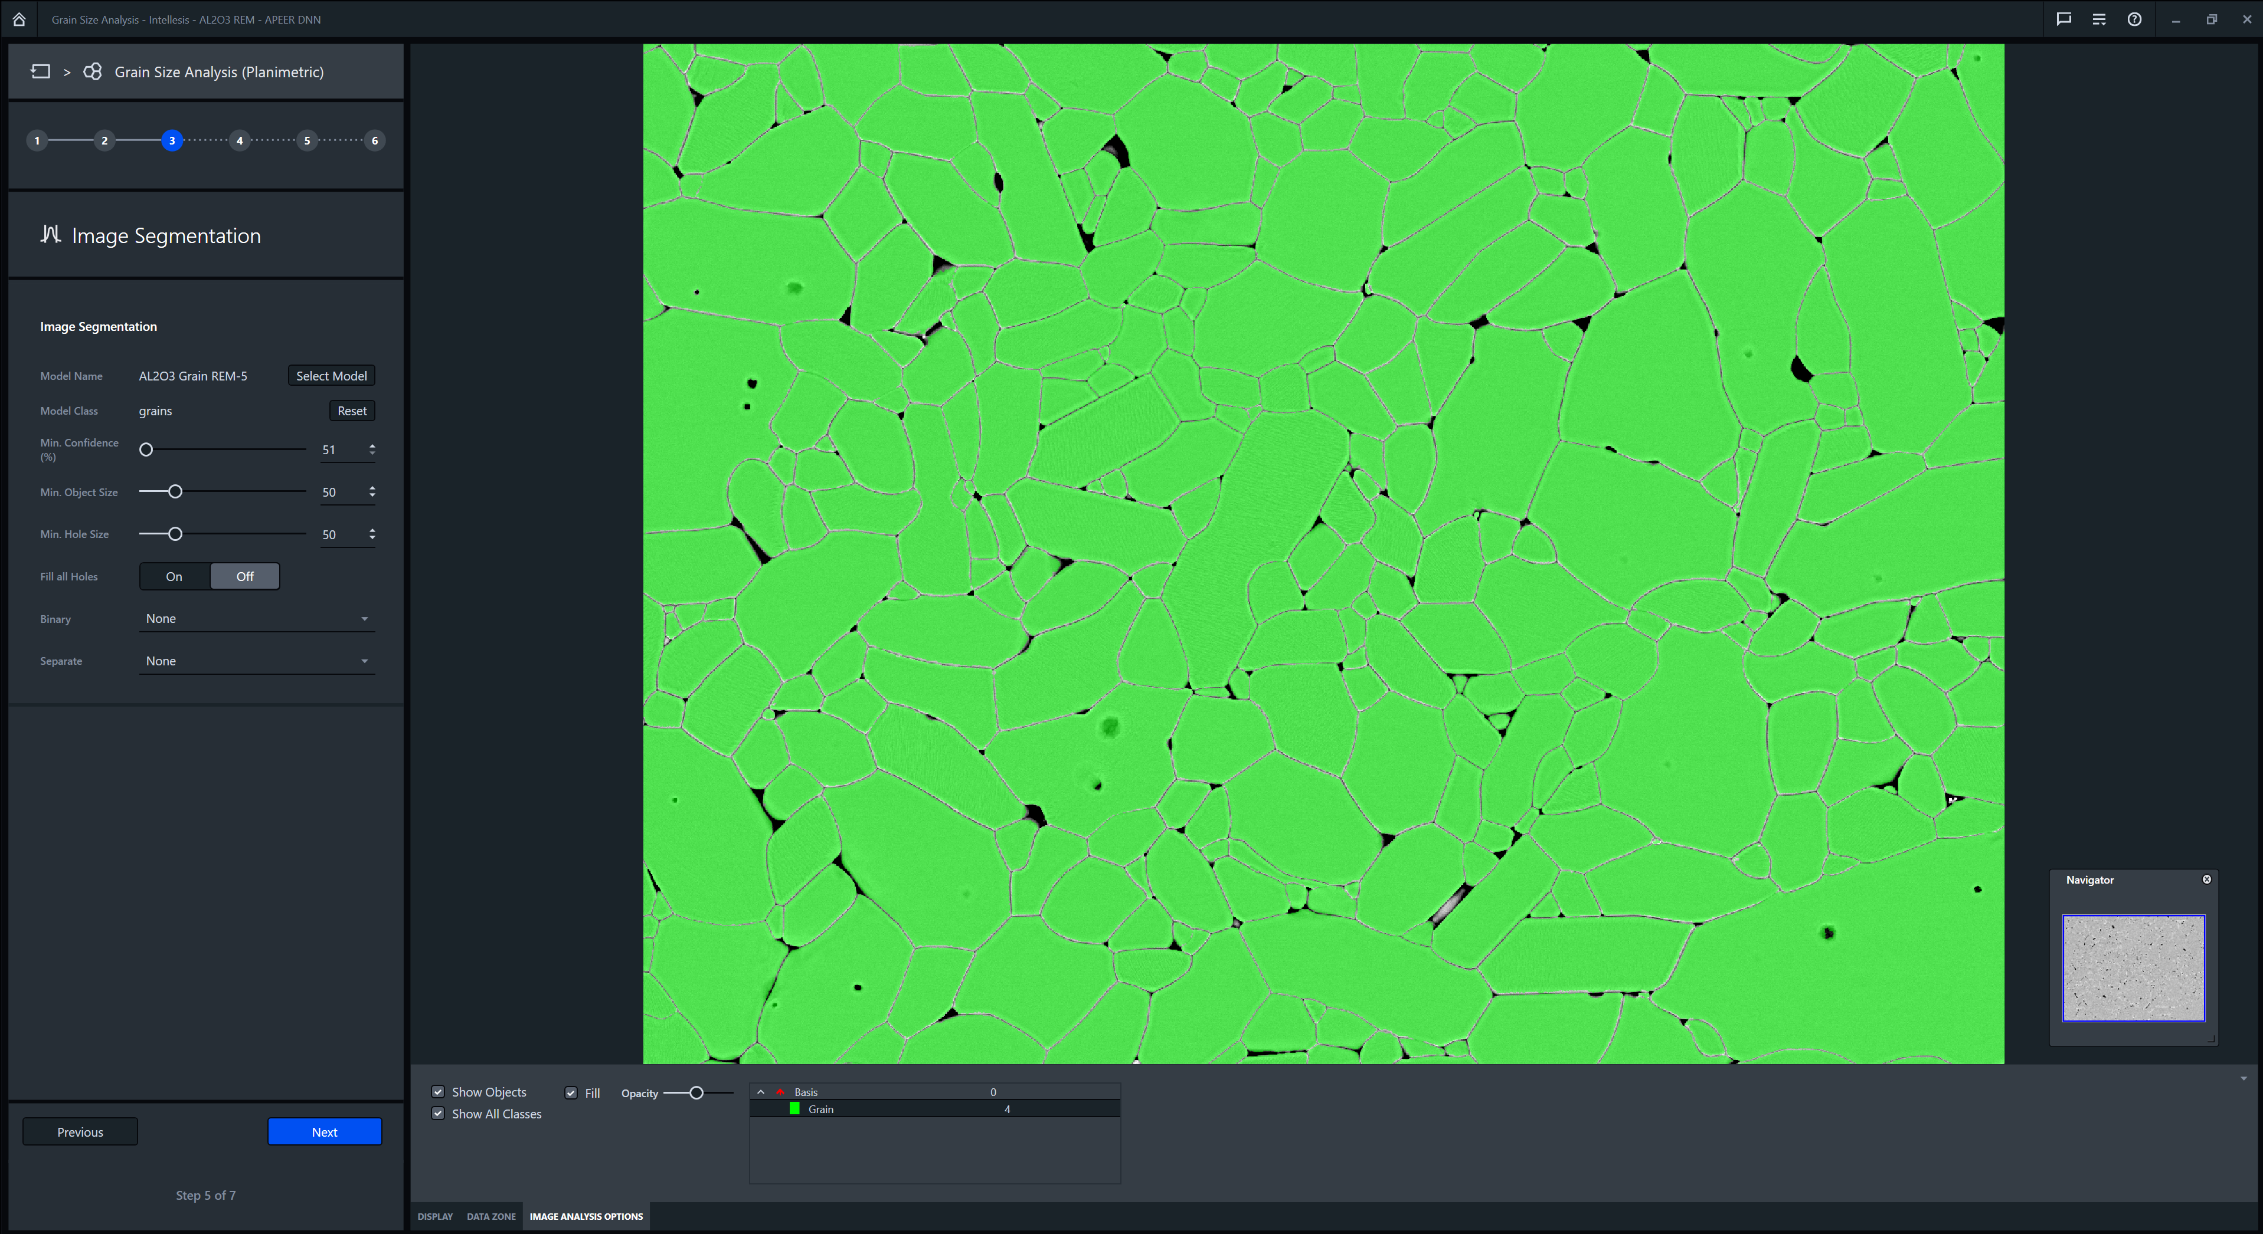
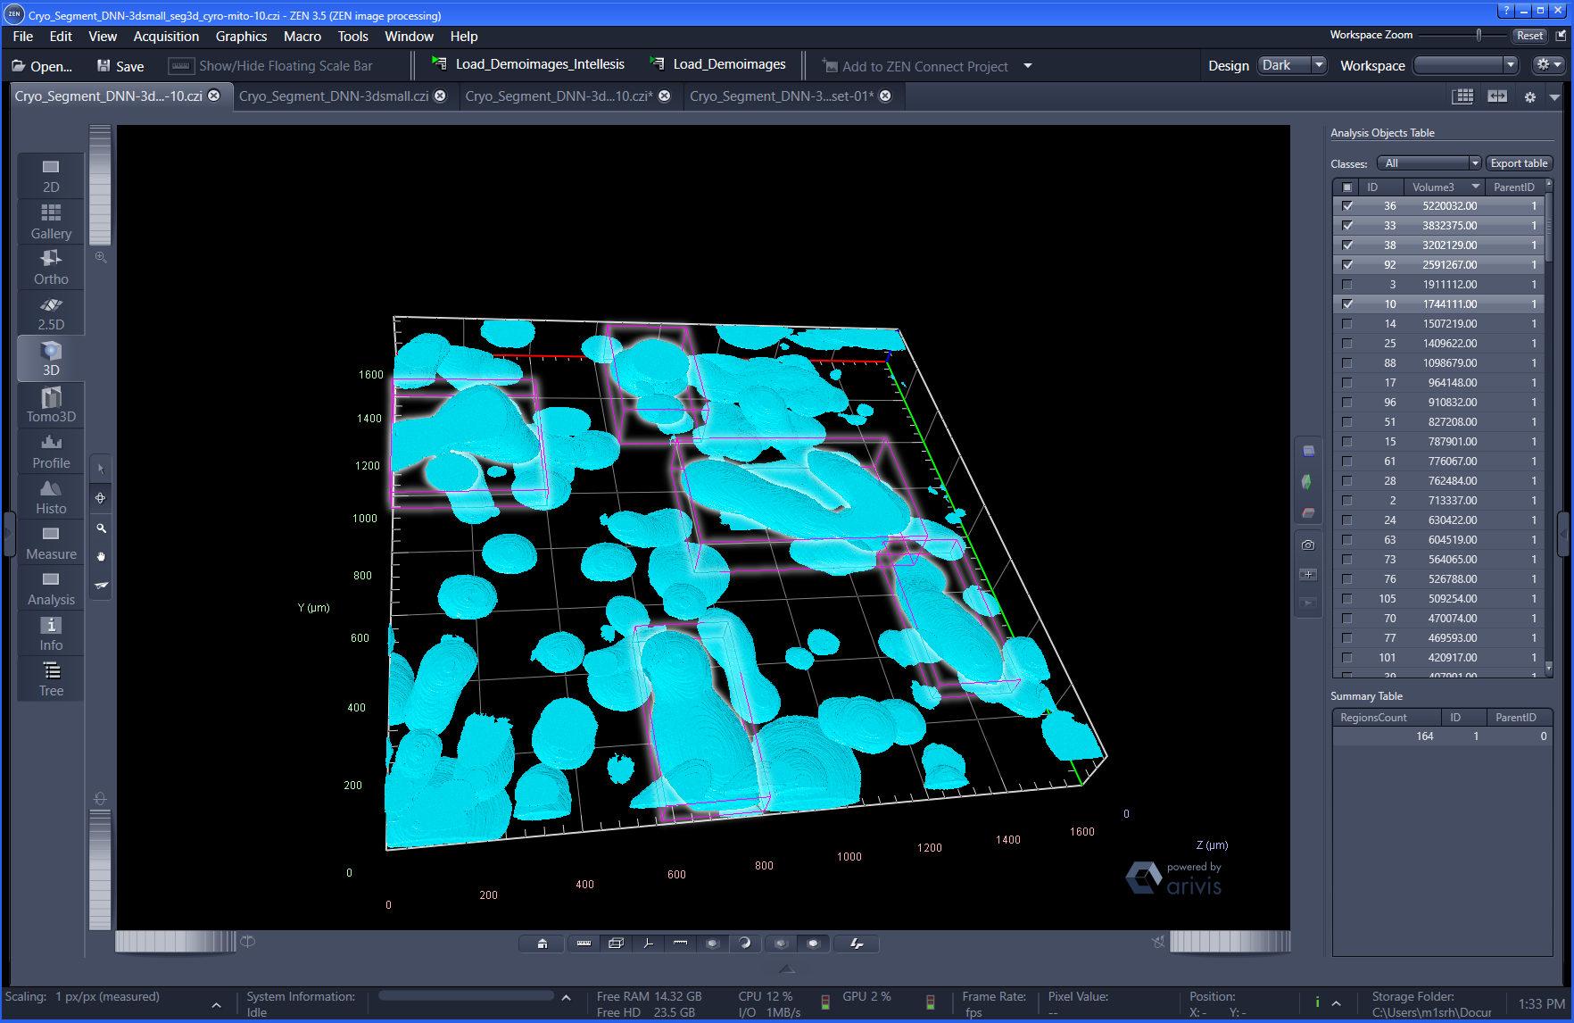
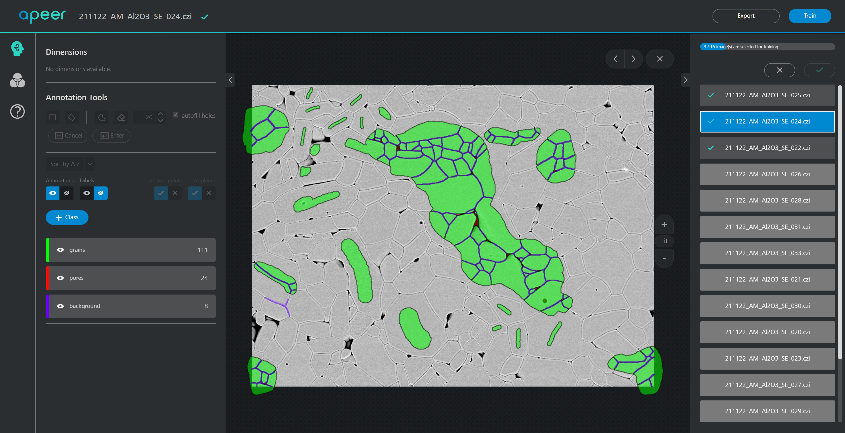
Concept: Train models “anywhere”
Train a model
In the cloud
Train a model
where you like
Train a model directly on your local machine
Trained Model
Get labelling and training a model as a paid service
ZEN blue, ZEN core, vision4D and APEER

Slide 6
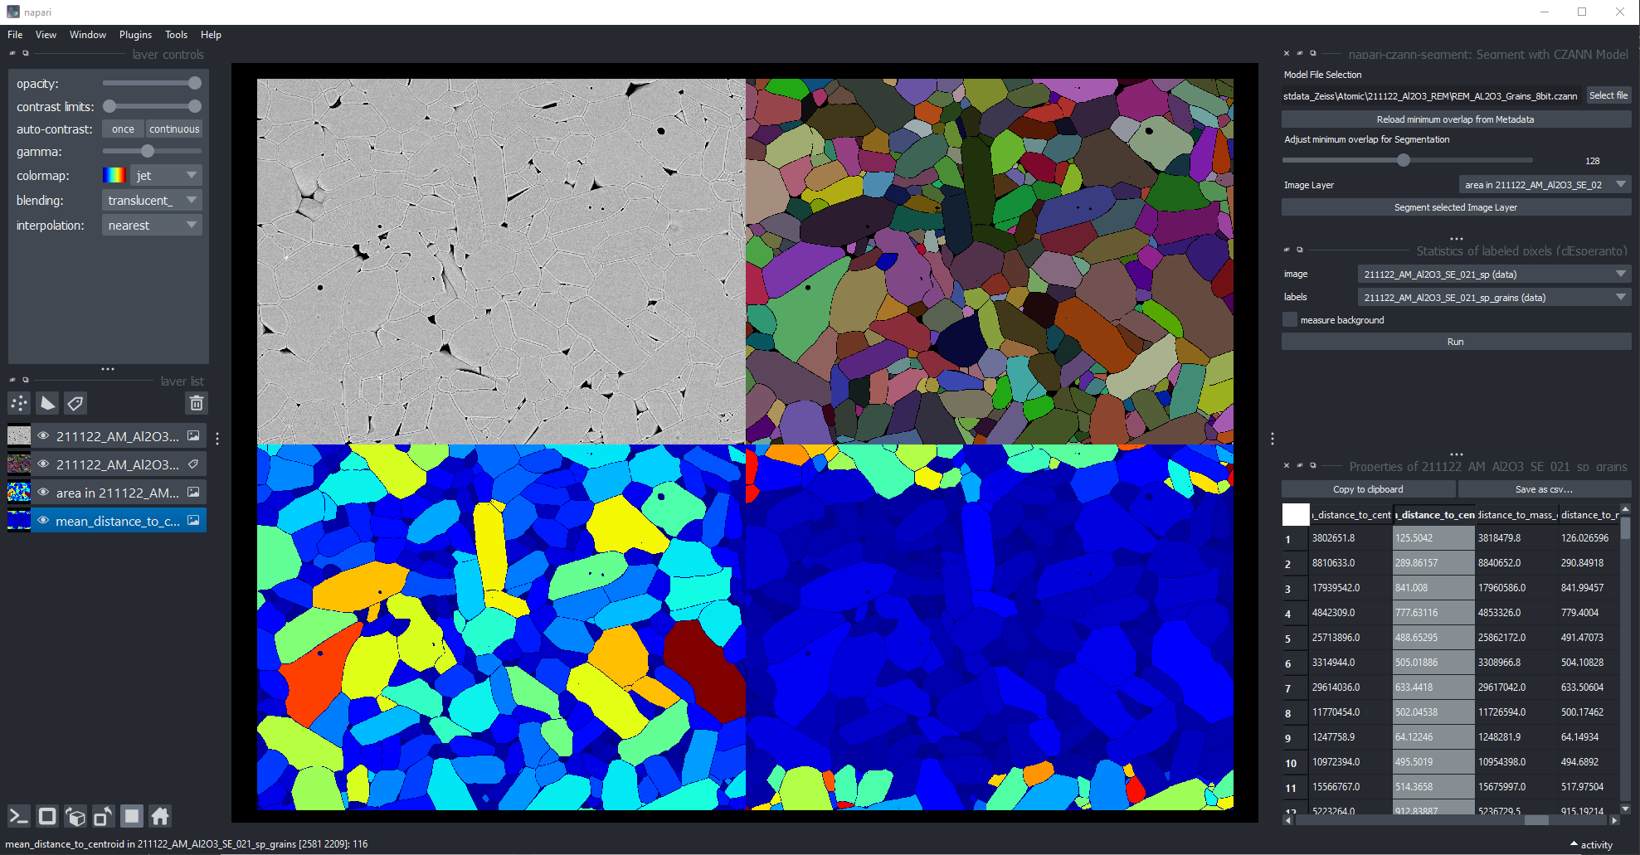
Open really means open – it also works inside “community software” *.czann trained on APEER executed inside Napari

Slide 7
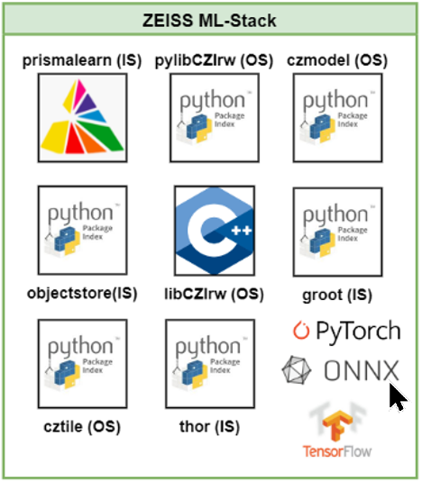
Our ecosystem - ZEISS Machine Learning Stack
ZEISS ML Stack
mainly Python-based internal (IS) and open-source (OS) packages
easy to deploy & use in different development teams @ZEISS
clear rules that those packages must the 1st choice when starting new projects
test coverage and code-quality standards cannot be just be “nice thing to have” but are crucial

Slide 8
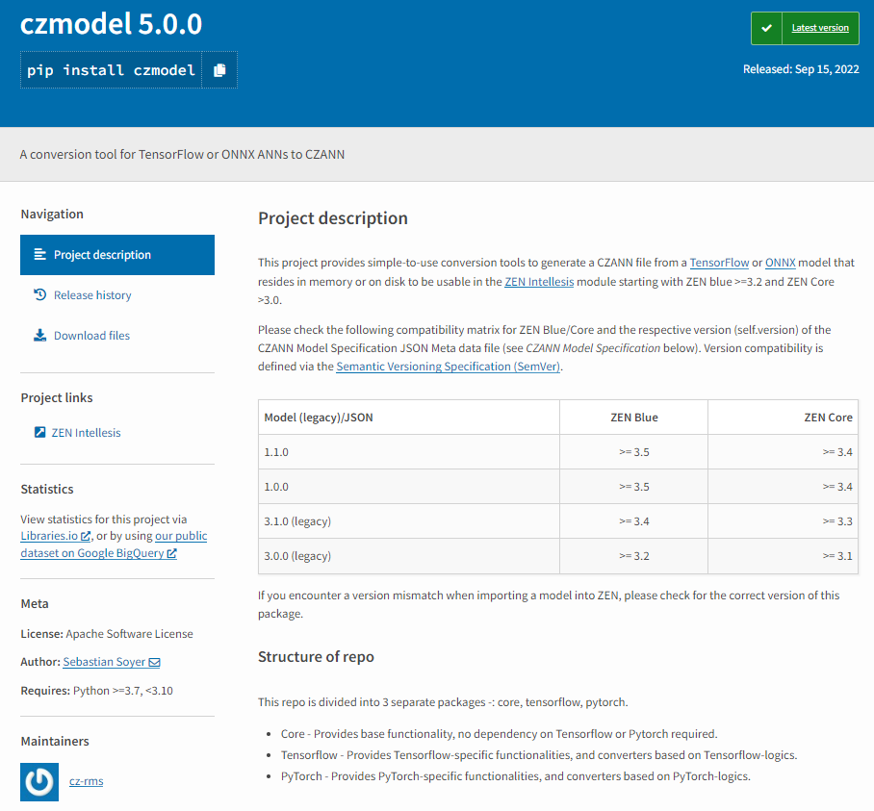
Open-Source python package czmodel Store model along with metadata
Open and standardized “container” to store ML models and metadata
is the “glue” between SW tools for Machine-Learning at ZEISS
no new model format
support for ONNX and TF2.SavedModels (legacy) models
used by ZEN blue, ZEN core, APEER-ML and vision4D
allows external data scientists to integrate their own models in our tools

Slide 9
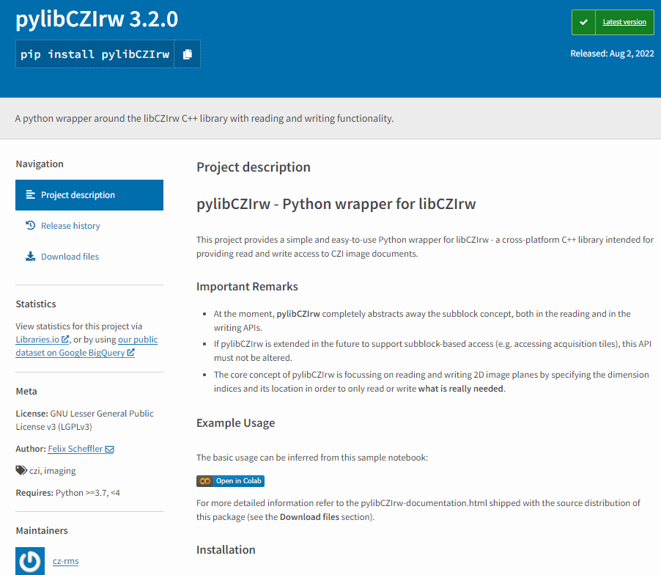
Open-Source python package pylibCZIrw Read and write CZI images format in your python environment
easily read and write multi-dimensional image datasets as CZIs from Python using a simple API
based on libCZIrw (C++) library (to be published soon)
focus on the real application code and not an DataIO … ☺
allows reading and writing parts of an CZI image
ensure that the output works in ZEISS tools

Slide 10
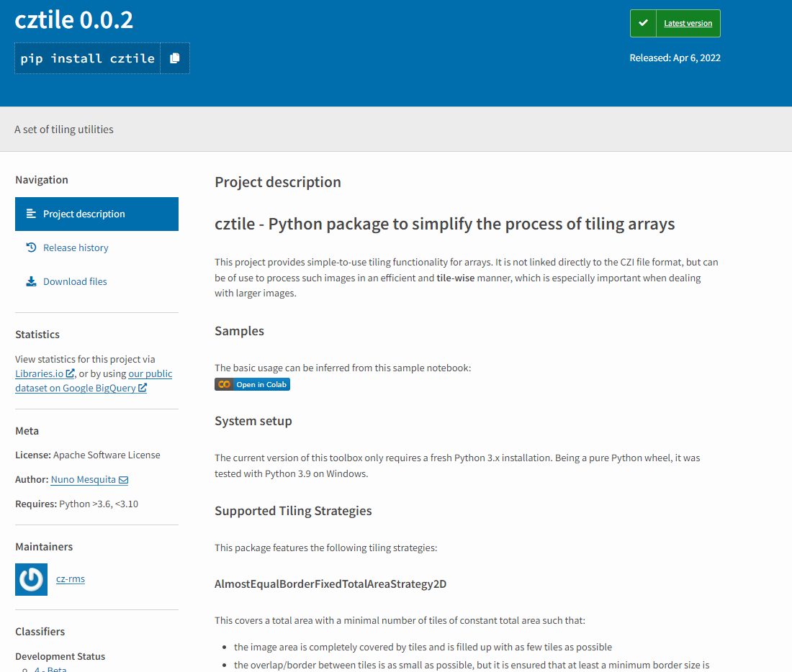
Use a tiling method to process (big) arrays Open-Source python package cztile
General library to create identical tiles with overlap for an array
not limited to CZI images or any specific format
Can be directly used together with pylibCZIrw to read and write tiles
focus on application code and not on re-inventing “tiling” over and over …
“unified” tiling algorithm gives consistent results

Slide 11
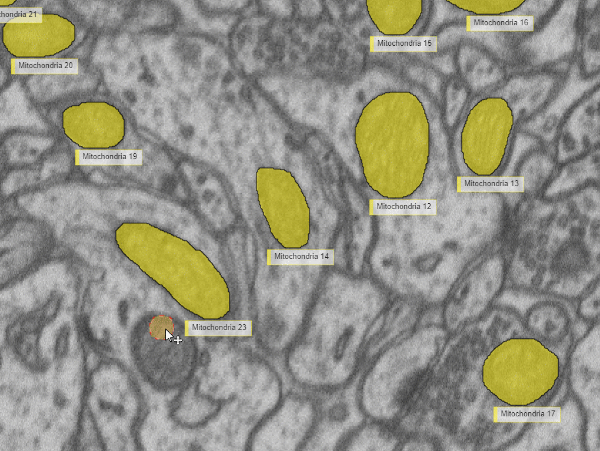
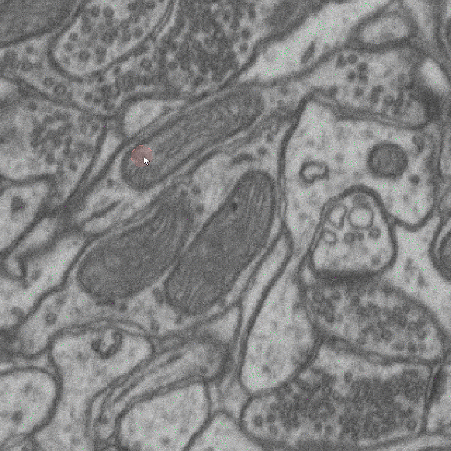
APEER-ML – Data-Driven Model Development “Better Data beats better models”
Annotate on APEER
Train your specific U-net
Download the model and use in ZEN or V4D or Napari or …

Slide 12
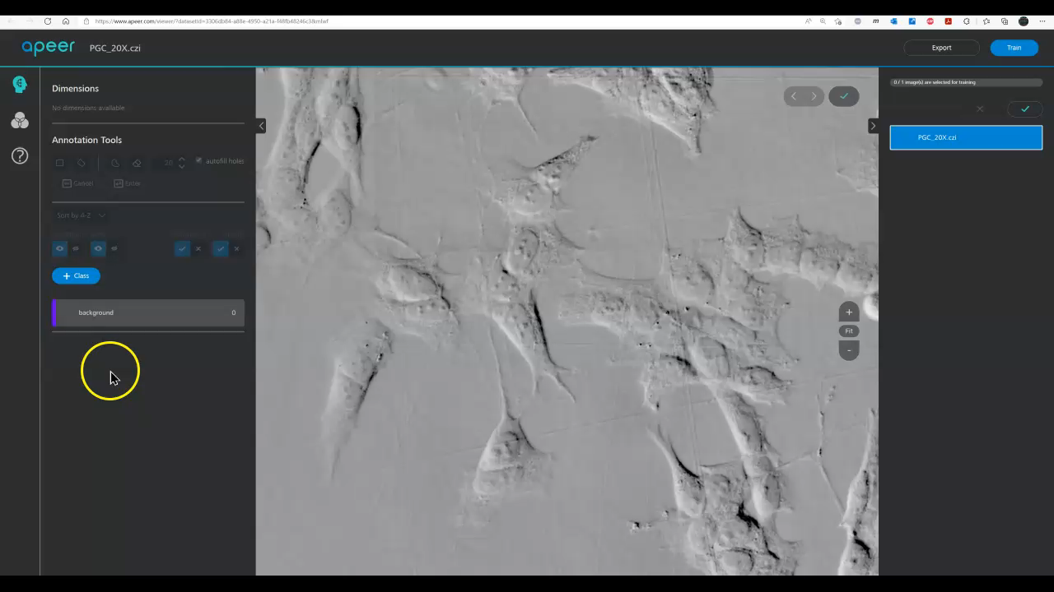
The ecosystem in action

Slide 13
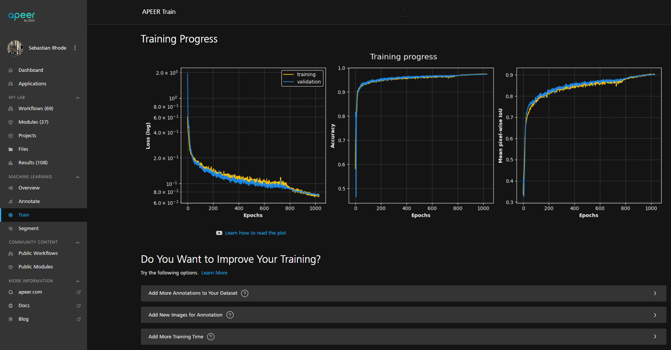
Fully automated Training pipeline
Download Model or continue training

Slide 14
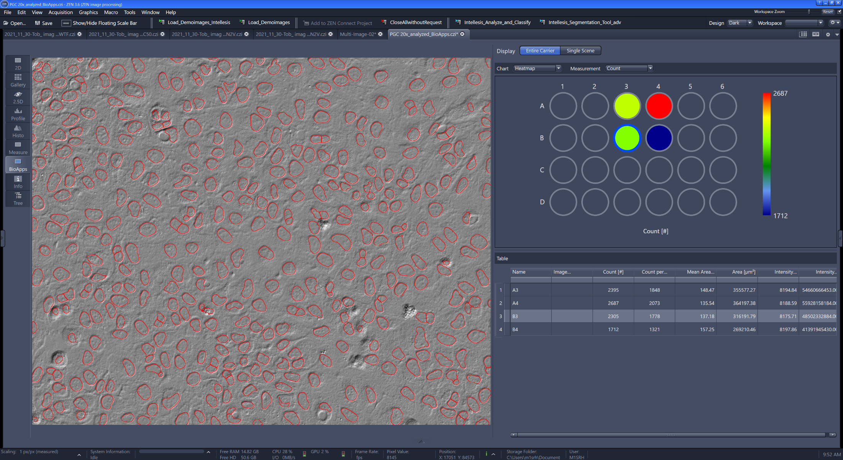
Application Examples – Life Science
Label-Free Segmentation inside a ZEN BioApp

Slide 15
Links and additional information
------------------------------------------------ Python Stuff and APEER ------------------------------------------------
https://www.apeer.com/app/machine-learning/overview
https://pypi.org/project/pylibCZIrw/
https://pypi.org/project/czmodel/
https://pypi.org/project/cztile/
https://www.napari-hub.org/plugins/napari-czann-segment (experimental)
------------------------------------------------ Additional Content ------------------------------------------------
https://www.zeiss.com/microscopy/int/website/landingpages/zen-intellesis.html
https://github.com/zeiss-microscopy/OAD/tree/master/Machine_Learning
https://github.com/ZEISS/libczi

Slide 16


